Slide 1


American Express Credit Card Default Prediction
Camilo Durango S, MSc.
Capstone Project, Data Science Program

Slide 2
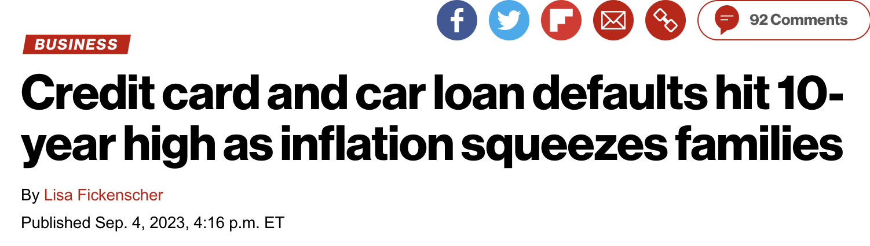


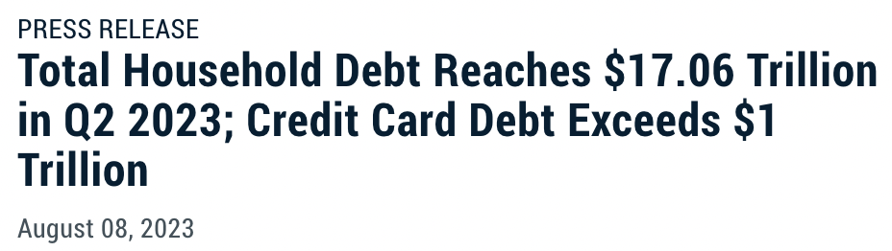
Challenge & Context

Slide 3

Harnessing Data Science to Mitigate Financial Risk
Business Challenge:
Increasing credit defaults and delinquencies amid rising credit card usage.
Objective:
Predict customer credit default likelihood.
Proactively manage credit risk to safeguard revenue and financial stability.

Slide 4
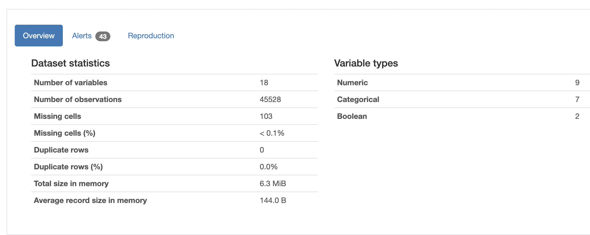
Data Wrangling
Dataset Overview
45,2528 customer records across 19 columns.

Slide 5
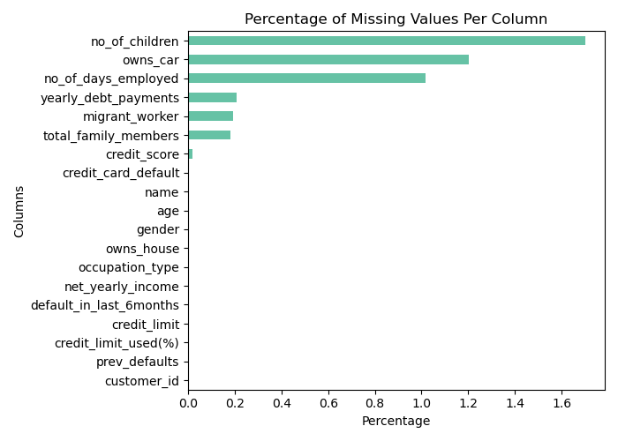

Data Wrangling
Cleaned data handling missing values and nomenclature.
Records from 2021 American Express Code Lab.

Slide 6
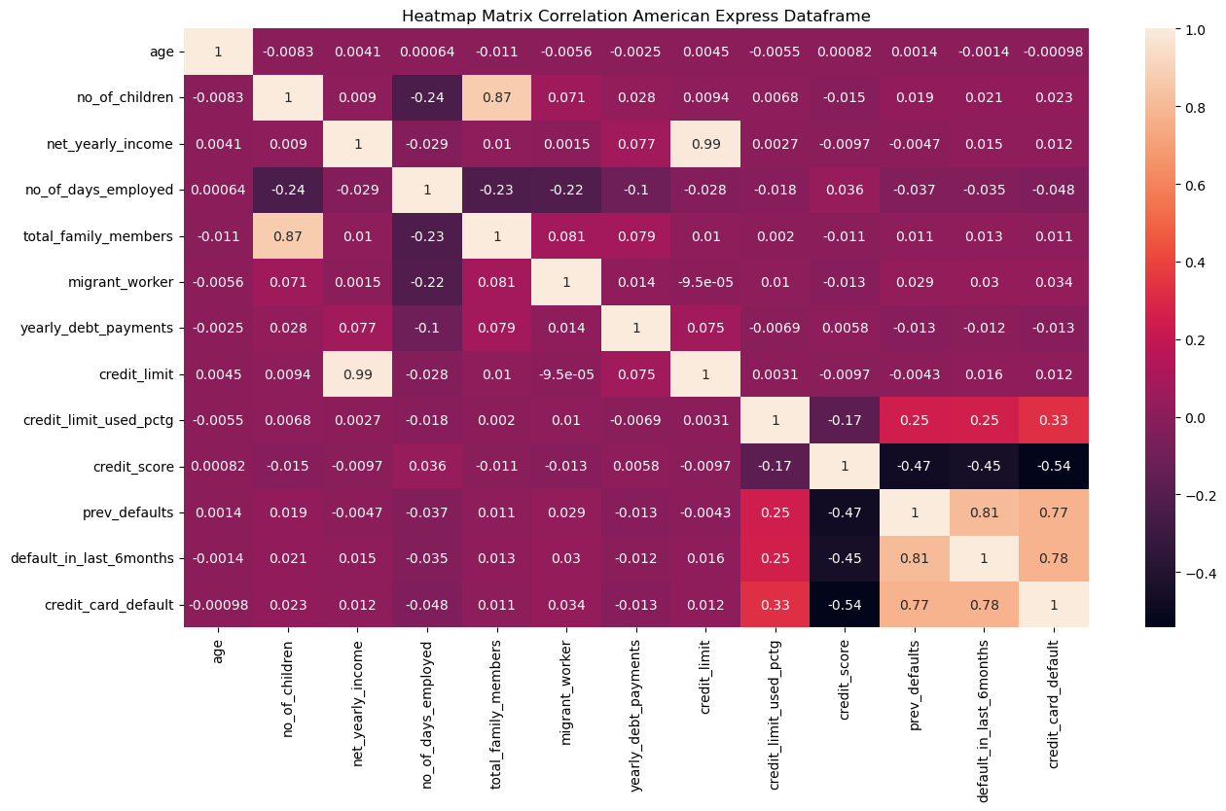
Exploratory Data Analysis
Class imbalanced Multicollinearity Bernoulli Distribution Y

Slide 7
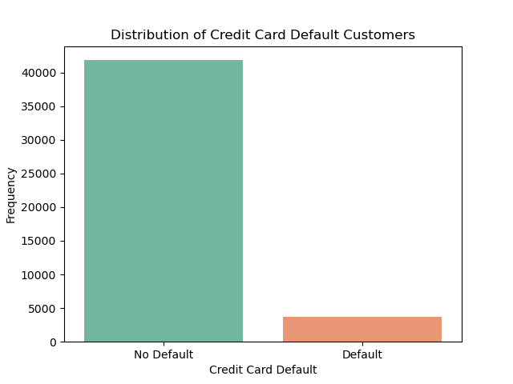
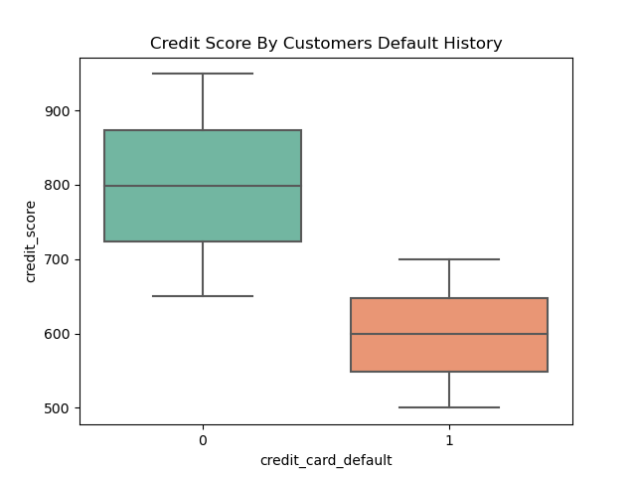
Exploratory Data Analysis
Class imbalanced Multicollinearity Bernoulli Distribution Y

Slide 8
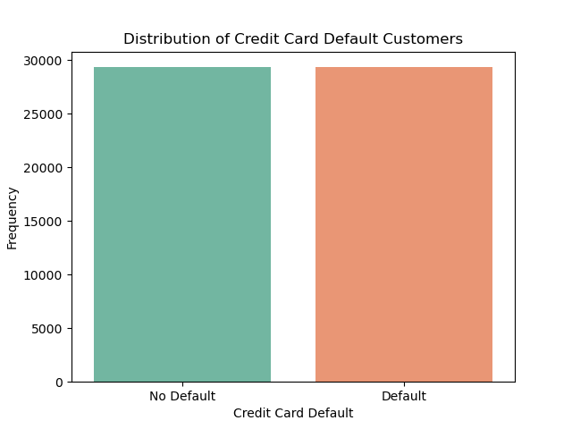

Data Preprocessing
Utilized SMOTE to balance classes
Feature Engineering

Slide 9

Model Selection – Default Evaluation
Model | Train AUC-PRC | Test AUC-PRC | Train AUC-ROC | Test AU-ROC
Random Forest Classifier | 1.0 | 0.999637 | 1.0 | 0.999649
K-NN Classifier | 0.999414 | 0.982557 | 0.999639 | 0.990969
Bernoulli Naïve Bayes | 0.937956 | 0.937906 | 0.914634 | 0.914550
XGBoost Classifier | 0.999998 | 0.999633 | 0.999998 | 0.999626

Slide 10

RandomizedSearchCV
Model | AUC-ROC Test Set
Random Forest Classifier | 0.994454
K-NN Classifier | 0.976874
Bernoulli Naïve Bayes | 0.982254
XGBoost Classifier | 0.994303

Slide 11
XGBoost Classifier
Robustness
0.994
AUC-ROC: 0.994
Scalability & Overfitting Control Techniques
Metric: AUC-ROC

Slide 12

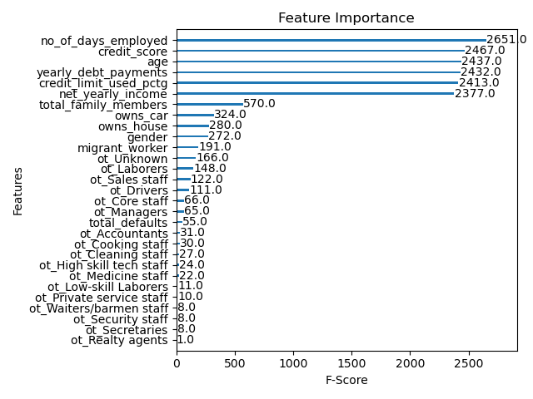

Model Interpretation

Slide 13

Predicting Credit Card Default Likelihood – Conclusions
Data Wrangling
Exploratory Data Analysis
XGBoost model demonstrated superior predictive performance of defaults.
Feature selection can be weighted based on importance.
American Express could apply the model as second filter before issuing credit.
Data Preprocessing
Training
Modeling
Deployment

Slide 14

Thanks!
Any questions?
You can find me at
Github Camilo Durango
camilodurangos@gmail.com
LinkedIn Camilo Durango

Slide 15
Credits
Special thanks to all the people who made and released these awesome resources for free:
Presentation template by SlidesCarnival
Photographs by Unsplash
New York Post
Federal Bank Reserve

